Slide 1
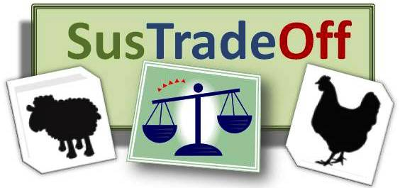
SusTradeOff
Understanding trade-offs between health and efficiency to improve competitiveness and sustainability of animal production by breeding and management
Marie-Hélène Pinard-van der Laan

Slide 2


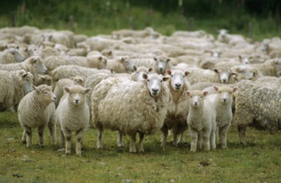
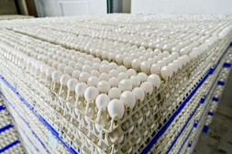

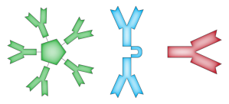
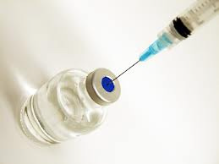
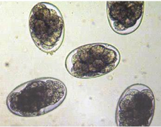
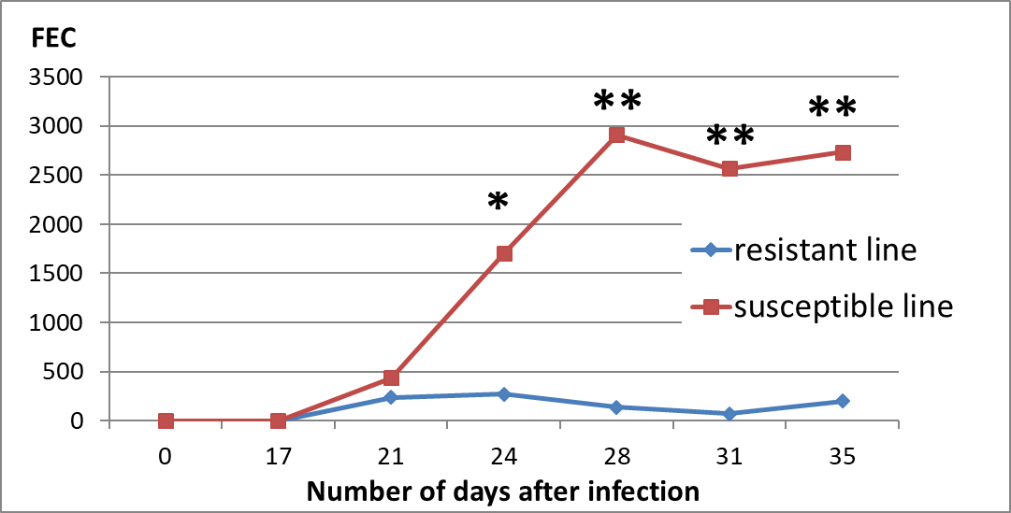
Project description
Hypothesis:
Resources allocated to production at the expense of other physiological processes like immune function
Selection for weight gain & egg/milk yield
TradeOffs
Objectives:
Understand in sheep & poultry how protein diets, genetics, production stage, vaccination/disease
DIETS
NUTRITION
affect protein allocation between production & immune function
TURN OVER PROTEINS
PROTEOMICS
RESOURCE
ALLOCATION
IMMUNOLOGY
BIOMARKERS
GROWTH, FE, ...
HEALTH
PRODUCTION
GENETICS
GENOMICS, QTL, RNAseq...
PRODUCTION IN THE FIELD

Slide 3
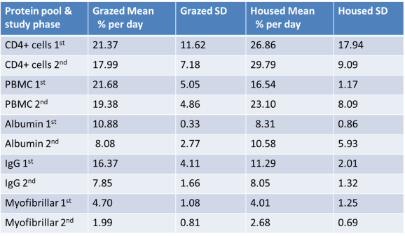
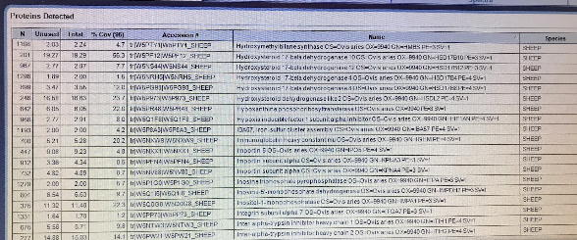
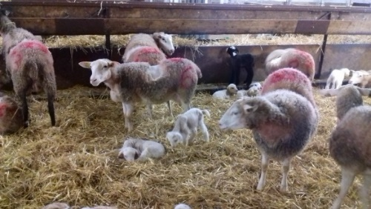
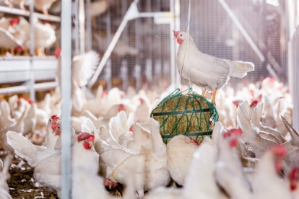
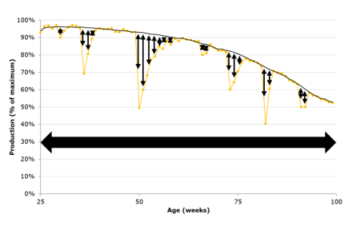
Preliminary results
Assessment of D₂O protocols for sheep & chicken : - Deuterium excretion kinetics as expected – turnover grazed > housed sheep - Fractional synthesis rates calculated for CD4 T-cells, PBMC, albumin, IgG, myofibrillar protein
SWATH-MS platform developed + LC-MS proteomics methods established for sheep samples: - detection & quantification of selected protein marker panels, e.g. for muscle growth
and immune response (# 400)
Sheep resource allocation model experiment: - During growth, strong resistance to parasite infestation associated with slower fat deposition in R line (% S line) - modelling of nutrient allocation
Resilience indicators based on BW variation & its relation with natural antibody levels in layers: - relation between resilience & immunity – h² resilience indicators

Slide 4

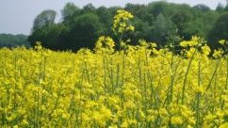
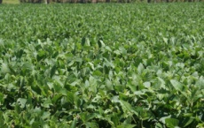

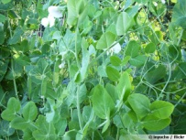
Contribution to SusAn research objectives :
Contribution of SusTradeOff
SusAn objectives
Understand trade-offs between health and efficiency, to improve competitiveness and sustainability of animal production by breeding and management
To improve the competitiveness and resilience of the entire animal production chain;
To produce animal products which are of high quality and represent good value for money for consumers and the processing industry
Delivering more efficient use of protein and facilitating the use of more diverse protein feedstocks
To make prudent and efficient use of natural and non- or poorly renewable resources (e.g. water, fossil fuels, land, nutrients and genetics);
To make more efficient utilisation of feed, taking into account land use and quality to achieve an optimum balance between the competition for food and feed production

Slide 5
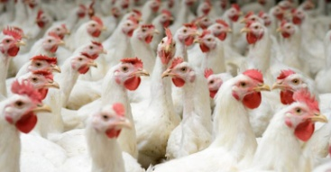
Contribution to SusAn research objectives :
Contribution of SusTradeOff
SusAn objectives
Understand trade-offs between health and efficiency, to improve competitiveness and sustainability of animal production by breeding and management
To minimise emissions to soils and water (e.g. nitrate, nutrients, pesticides and drug residues)
To develop systems meeting societal needs and values, for example high standards of animal health and welfare, including minimising the use of antibiotics
Aspiring to integrate ration formulation with breeding and health management
Improve on farm practices and address societal challenges associated with animal welfare
Preserving immunocompetence will also reduce disease burden and improve welfare

Slide 6
Research Impact on the 3 pillars of sustainability:
Does the project adequately address the different pillars? How do the different pillars contribute to the aim of your project?
SOCIAL ACCEPTANCE
Uptake by food and breeding industry of novel management and breeding practices
Improved health and welfare leading to better societal acceptance
More diverse use of protein
resources to preserve and better
share natural resources
Optimised health
management to reduce
drug residues and
resistance
NUTRITION
IN THE FIELD
RESOURCE
ALLOCATION
IN THE FIELD
HEALTH
PRODUCTION
GENETICS
PRODUCTION IN THE FIELD
PROTECTING ENVIRONMENT
ECONOMIC COMPETITIVENESS
More efficient use of protein resources to make the livestock sector more competitive and resilient to changes in commodity prices and feedstock availability
Healthier animals to reduce direct and indirect costs of diseases

Slide 7
Research Impact on the 3 pillars of sustainability:
How relevant are the links made between the pillars?
SOCIAL ACCEPTANCE
Environmental Issues
Market
Short term -
NUTRITION
IN THE FIELD
RESOURCE
ALLOCATION
IN THE FIELD
HEALTH
PRODUCTION
GENETICS
PRODUCTION IN THE FIELD
PROTECTING ENVIRONMENT
Opposite Interest ?
Role of public policy ?
ECONOMIC COMPETITIVENESS
The three pillars are interlinked because of:
integrated strategy of SusTradeOff
- combined impact of more efficient protein use on long term improvements
in production system efficiency

Slide 8







Transnational collaboration:
What is the added value of transnational collaboration?
Transnational level = necessary to achieve a critical mass of scientists that cover all the expertise for the project
e.g. sheep analysis :
- sheep model R/S Haemonchus contortus + genetics
- D2O protocols to measure in vivo synthesis rates of proteins
- proteomics
Added value delivered through significant
- mobility and training
- sharing material from experiments between multiple laboratories (ethics - 3Rs)
Transnational collaboration = will benefit the pathways to impact:
Universities, technical institutes, breeding companies and farmer’s union having different and complementary territories, stakeholders and species coverage
e.g. BreedForFood consortium with Cobb and Hendrix partners

Slide 9

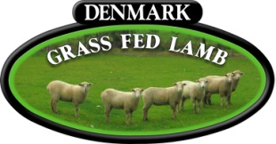

Transnational collaboration: Is the transnational collaboration beneficial for broad implementation of the results?
Results of SusTradeOff are relevant in more than one country !
- Sustainable global supply of protein for human nutrition
- Competition for resources and land use
= major transnational / global challenge
Promoting more responsible livestock systems: of interest for all countries !
- Sheep & poultry essential in poorer societies => results relevant
to addressing inequality gap between developed & developing countries
What is beneficial for broad implementation of the results :
Complementarity in transnational research
- species + knowledge + skills
Complementarity in transnational practices
- species + knowledge + market / type
Technical Institutes EU based multinational Organic

Slide 10






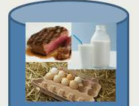
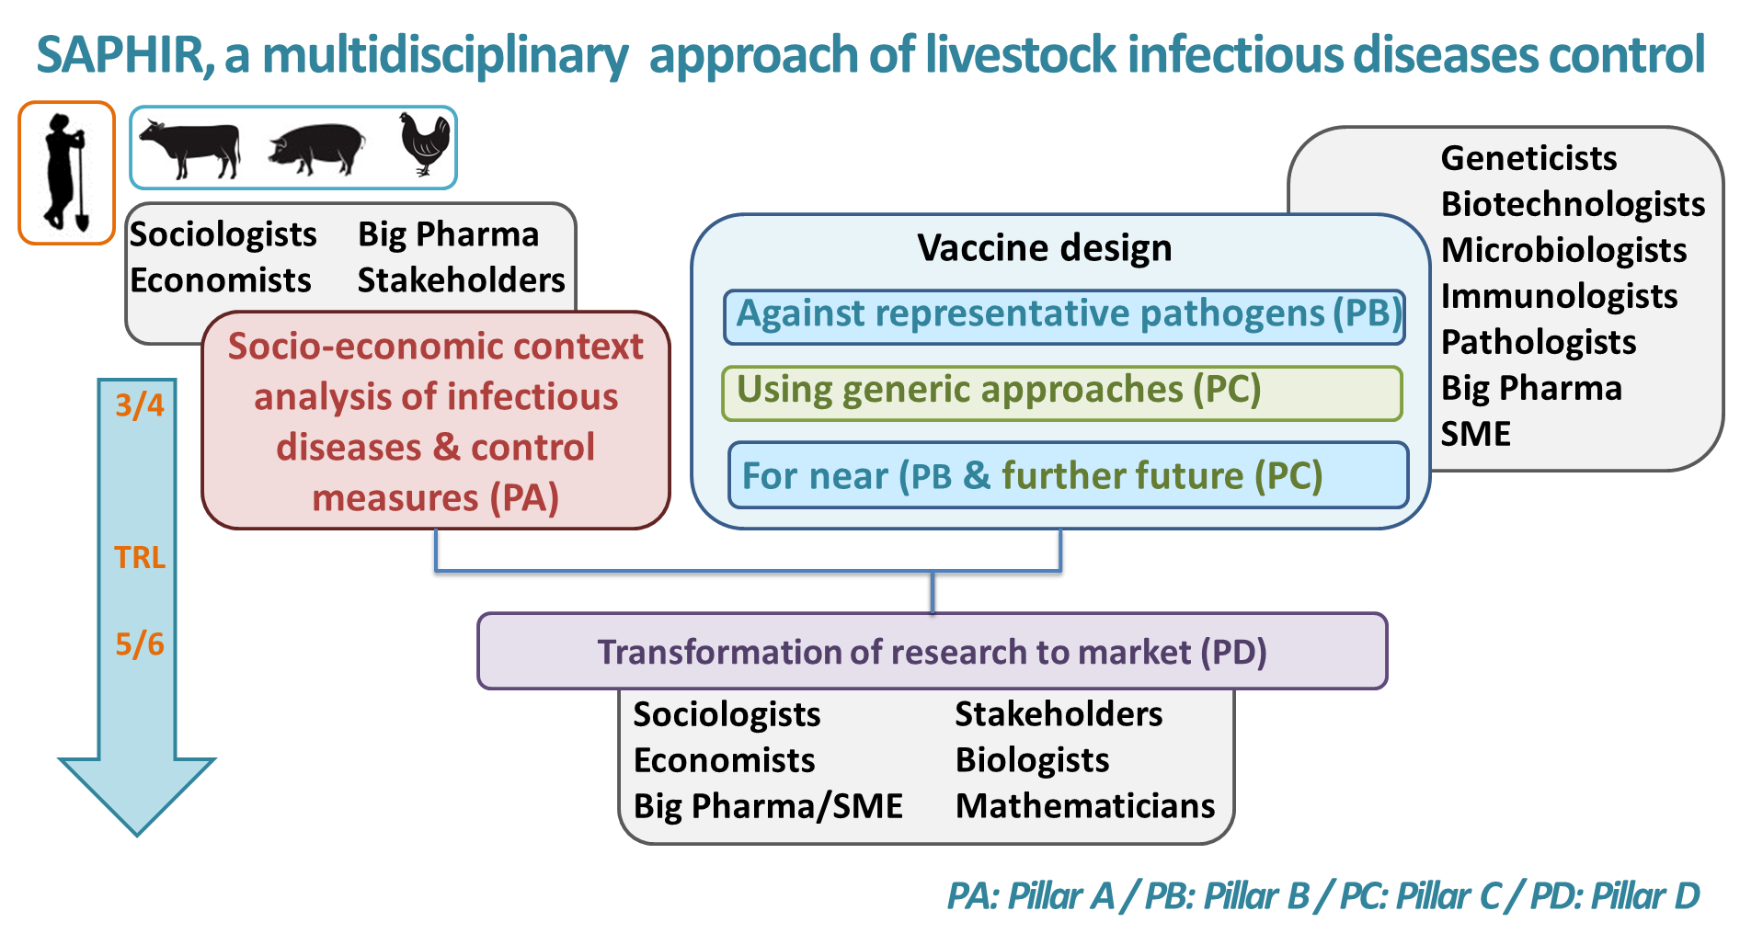

Multi actor approach: Is there a strategy to involve relevant stakeholders?
Targetting Stakeholders:
  Poultry breeders :
  Organic farming :
  Technical Institutes :
  Outside SusTradeOff : breeding + feeding industry + consumers
awareness + social acceptance => implementation
Involving Stakeholders :
  Dissemination of operationally validated proposals for
  improvements of breeding /on-farm practices
  Workshops with stakeholders (EU projects
  e.g. FeedAGene, policy makers and vet practices )

Slide 11
Multi actor approach: Are research outcomes validated under practical conditions along the whole value added chain?
WP2: Genetic basis of resource allocation:
=> to dissect the genetic basis of resource allocation between immune competence and production efficiency
2.1: Genetic background of trade-offs
- 3000 hens (Hendrix Genetics) phenotyped for Nab, +1000 hens genotyped + egg production + feed efficiency
Expected results: Genetic correlations and pleiotropic effects
Other results
no “commercial conditions”
or too preliminary (proteomics)
=> to be validated in an other project
2.2: Resilience and immunocompetence in lines
- Selected hens H/L Nab X not selected commercial roosters
- Nab + survival data recorded by Hendrix Genetics
Expected results: Validation whether selection on Nab will improve resilience and survival without negative side-effects on production or feed efficiency
Directly validated under practical conditions

Slide 12
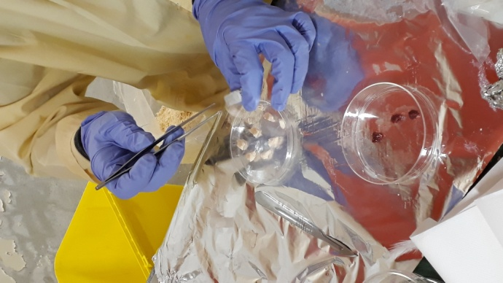
Cross-scale approach:
In how far does it make sense in the particular research project to target the different levels? How relevant are the interactions seen between the levels?
Three interdependent levels:
Animals
Populations
Production systems
New knowledge is needed at each level
e.g. understanding the biological basis of resource allocation between immunocompetence and production efficiency at the animal level
and between the levels
e.g. parameters from the animal level for the modeling at the population level, the genetic parameters at the population level for the scenarios at the production level
Multi-dimensional research approach
= crucial to build innovative and operationally integrated strategies
SYSTEM APPROACH

Slide 13
Cross-scale approach:
Which is the Impact of the project in terms of knowledge acquisition?
At the Animal level :
  Detailed data on Fractional Synthesis Rate of Proteins associated with muscle growth and immunocompetence
  Understand how this balance is influenced by dietary protein & genetics and how it relates to parasitological or vaccination outcomes
At the Population level:
  Usefulness of Nab in poultry breeding for more resilient animals
  Usefulness of resilience in sheep and poultry breeding
  Better understanding of actual trade-offs in breeding populations
At the Production systems level:
  Proof of concept for novel breeding strategies and practices and
  for more efficient use of protein resources
  Estimation of eco/environmental impact of these strategies in laying hens
  Better understanding of interest for/ from industry
  Better understanding of societal concerns

Slide 14

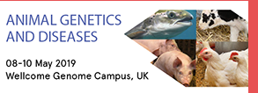


Dissemination and communication strategy:
Is there strategy for exploiting the potential of the projects results?
Towards Scientific community :
  Relevant Congresses …
  (specialist + generalist…)
  Publications …
  Per species only ? Interdisciplinary ?
Towards Stakeholders :
  Dissemination of operationally validated proposals for improvements of breeding /on-farm practices
  Workshops with stakeholders (EU projects
  e.g. FeedAGene, policy makers and vet practices )

Slide 15
Dissemination and communication strategy:
Do you disseminate the projects results via Open Data?
For articles :
  yes
For congresses:
  related to the congress policy

